Slide 1

Enhancing Semantic Search w/ Retrieval-Augmented Generation
Spin-off
César Soto Valero

Slide 2
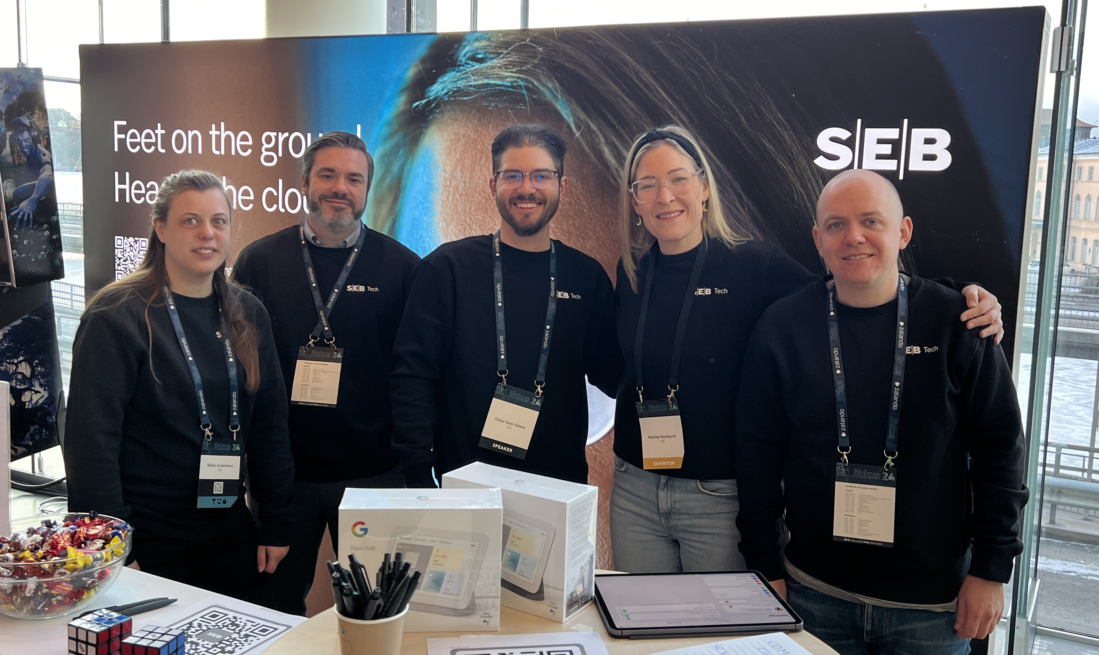

Slide 3
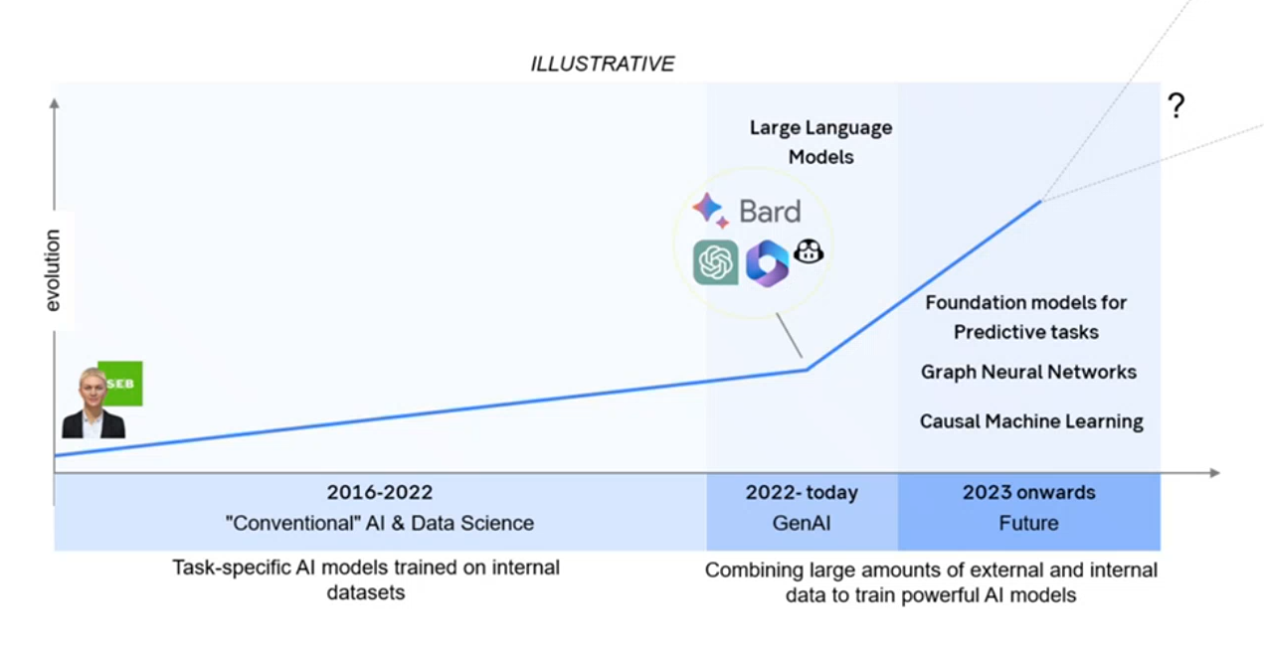
AI’s Evolution

Slide 4
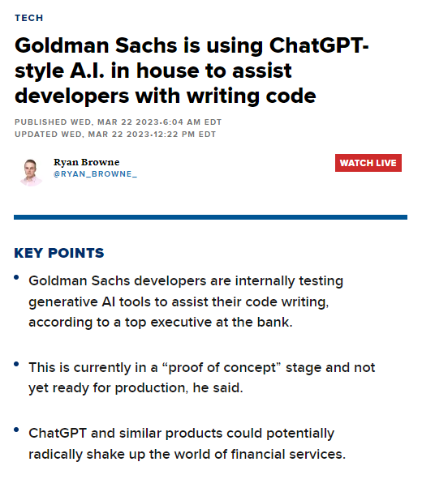
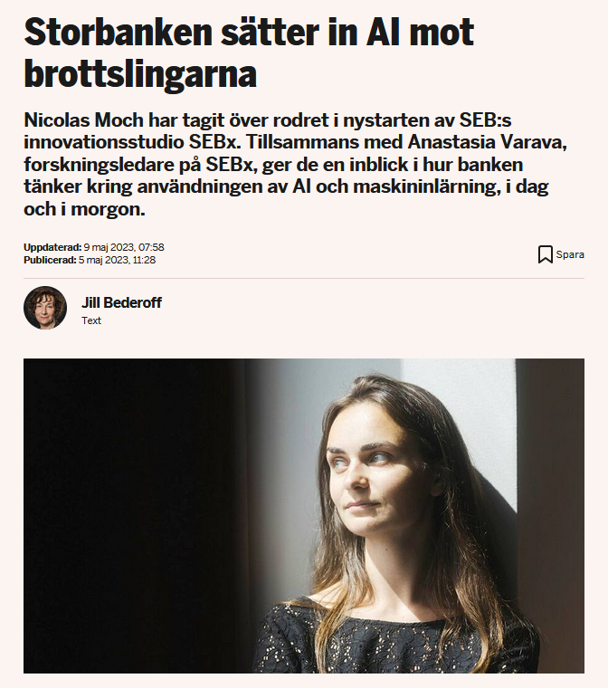
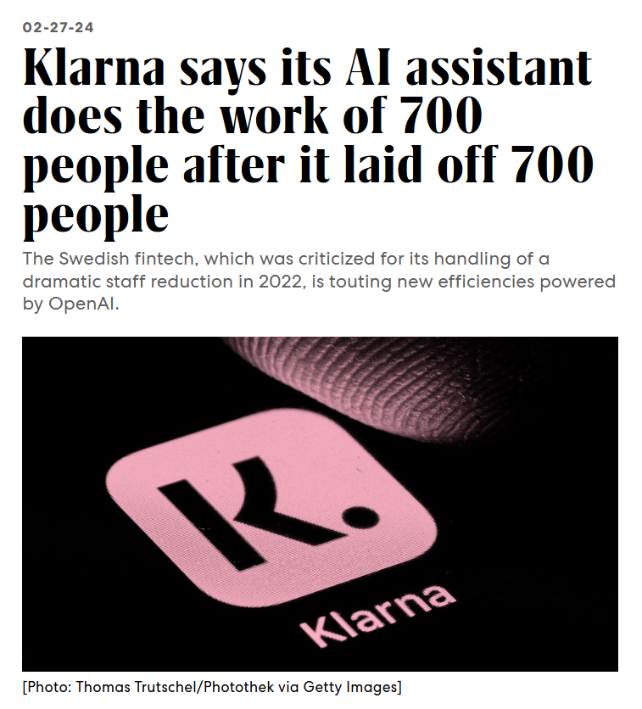
AI’s Revolution in Banking
Source: http://tinyurl.com/5crwyhte
Source: http://tinyurl.com/4t98ufvw
Source: http://tinyurl.com/crjrjveu

Slide 5
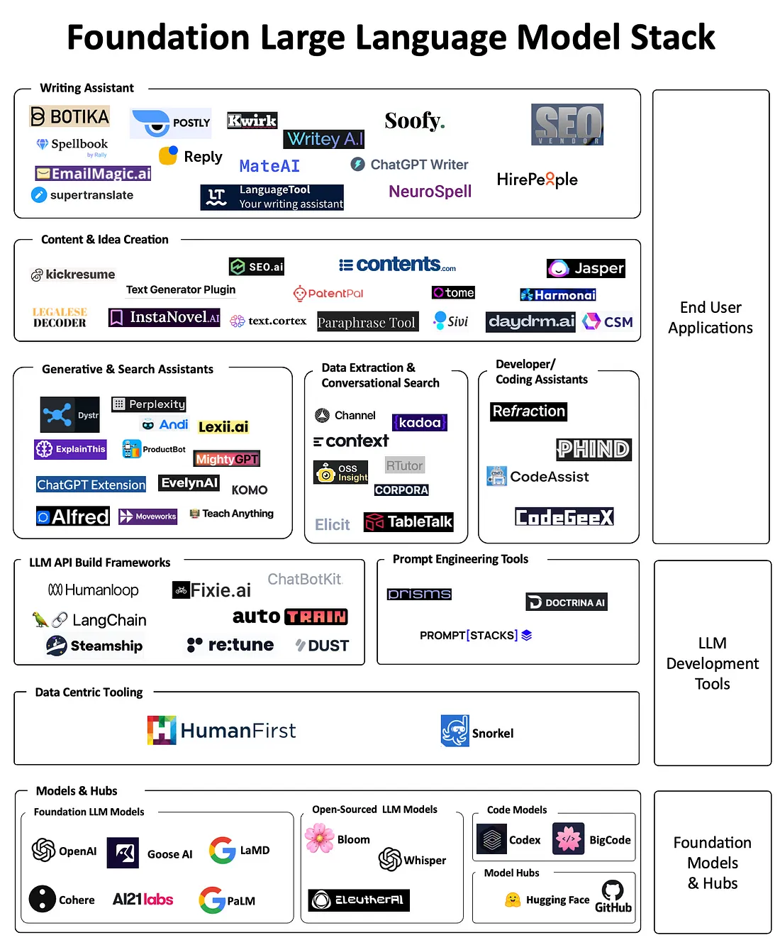
LLMs
New capabilities 🧠
General purpose models
Language “understanding”
Multimodality

Slide 6
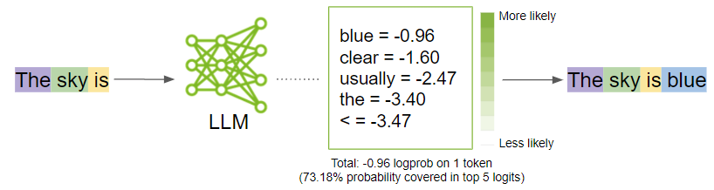
LLMs
Next word completer
Trained on large amount of text
Source: https://developer.nvidia.com/blog/how-to-get-better-outputs-from-your-large-language-model

Slide 7
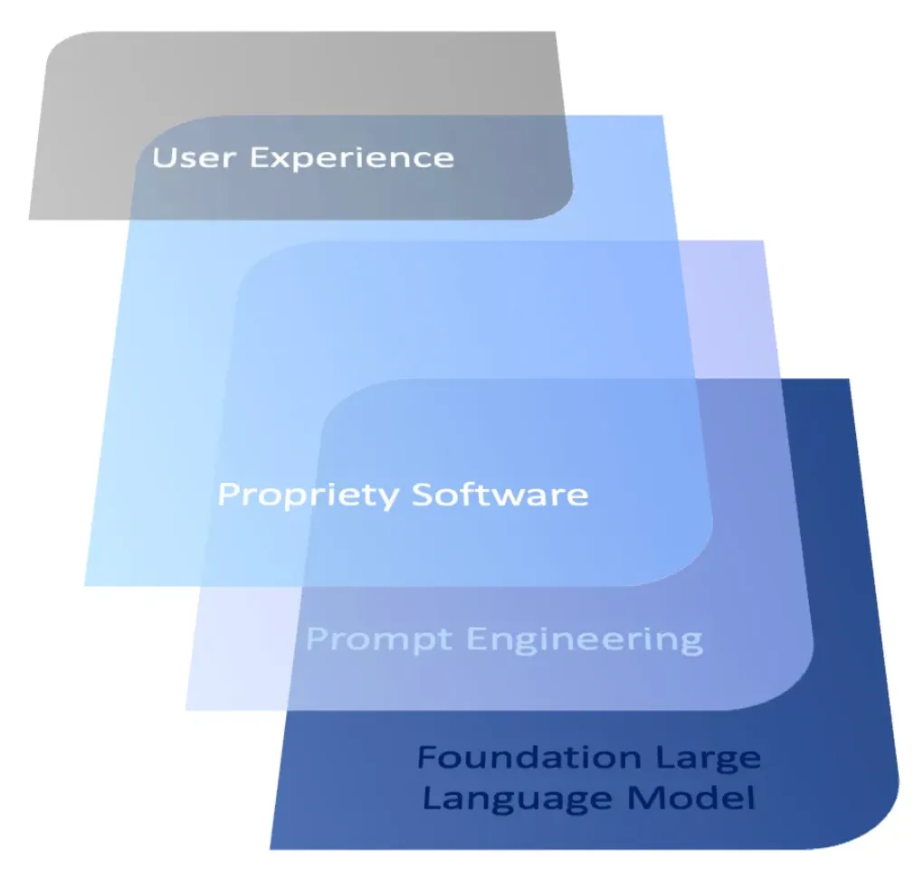
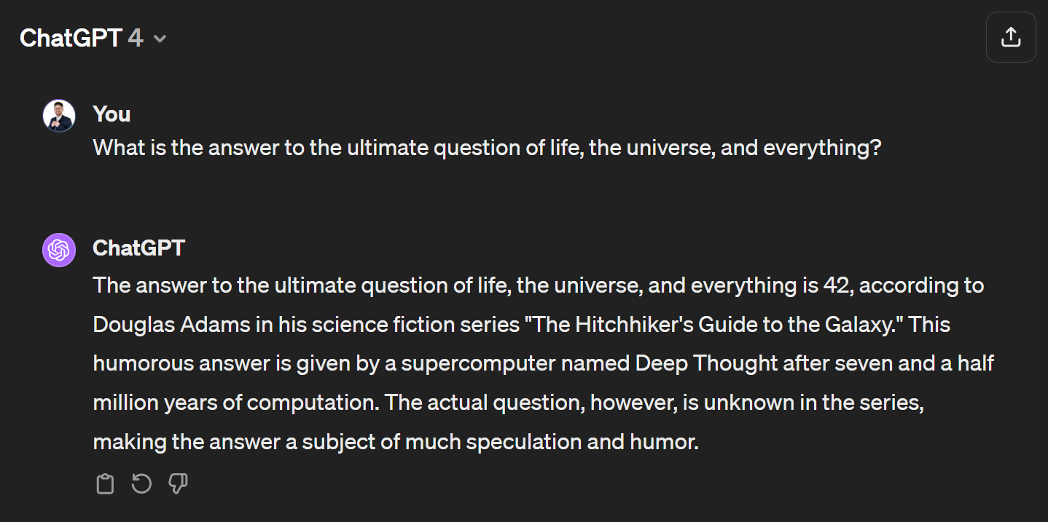
ChatGPT
LLMs + RL + Fine Tuning
Nice user interface
APIs

Slide 8
Shortcomings
Not internal information
Not updated information
Hallucinations
Not explainable responses
LLMs are generic, our business is not!

Slide 9
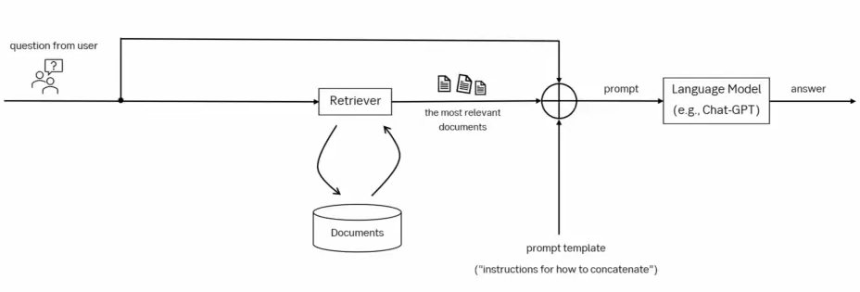
RAG
Source: Lewis, Patrick, et al. "Retrieval-augmented generation for knowledge-intensive nlp tasks.“, 2020

Slide 10
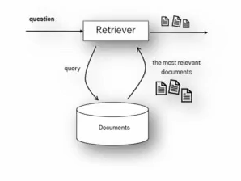
Retriever
The task is to find the most relevant documents to answer the question
E.g., if the question contains “loan”, the user expects documents using the word “mortgage”

Slide 11
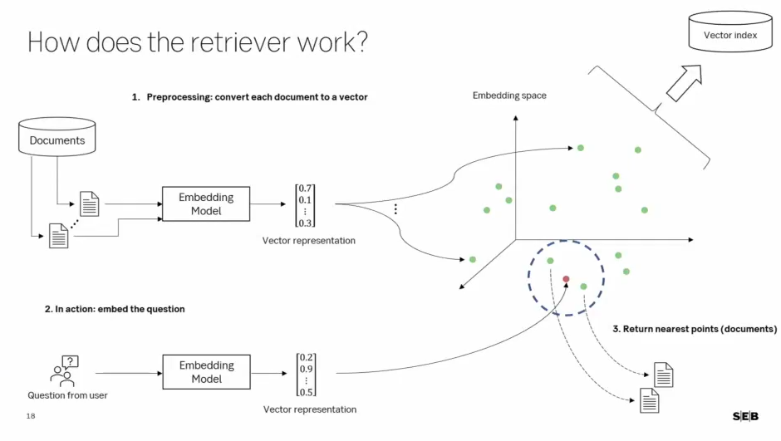
Retriever
Source: Georg Schuppe’s presentation at “SEBx AI Bootcamp Technical Track”, 2024

Slide 12
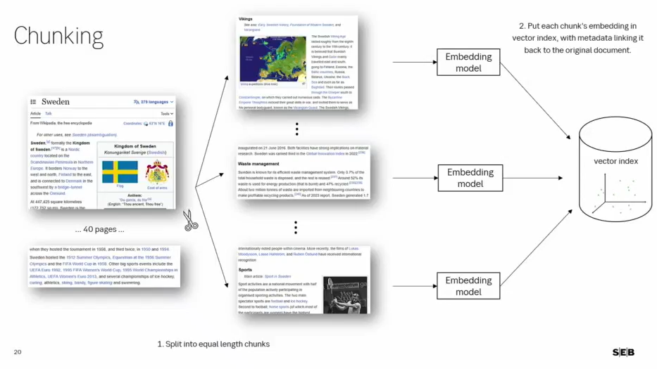
Chunking
Source: Georg Schuppe’s presentation at “SEBx AI Bootcamp Technical Track”, 2024

Slide 13
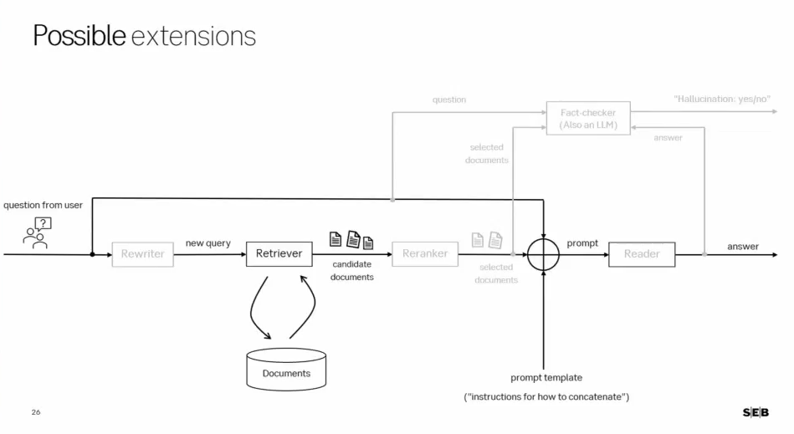
Enhancements
Source: Georg Schuppe’s presentation at “SEBx AI Bootcamp Technical Track”, 2024

Slide 14

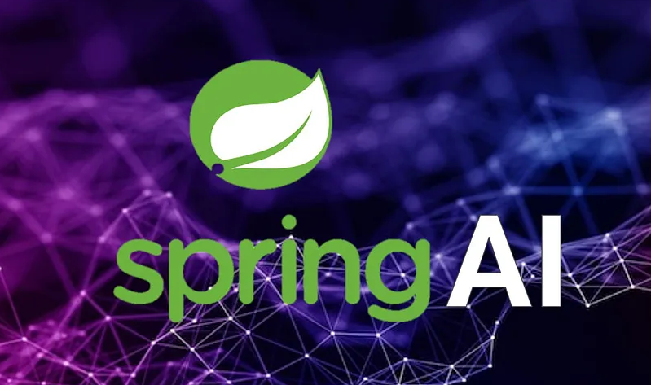

Java frameworks
LangChain4j
Spring AI
Rag4j

Slide 15
Demo time

